Slide 1


Communication Skills Part 1
Week 2: Reflective practice, Gibbs’ model, and Introduction

Slide 2
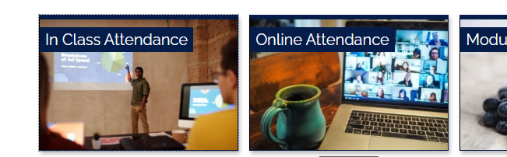

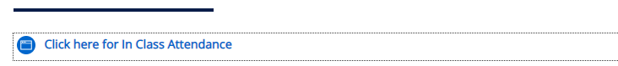

Registering your in-class attendance
Step 1: Ensure you are logged into the ARUL-Wi-Fi.
The password is: 1nt3rn3t@Arul
Step 2: Login to the VLE and go to the module page for your class.
Step 3: Click on In Class attendance
Step 4: Click on the link highlighted in blue. The word submitted will appear on your screen if you have followed the procedure
Step 5: Repeat this process for your AM/PM class
Notes:
Get all students to register their attendance for todays WW session
This is the process they will follow for attending classes next week, but they need to select the module they will be studying

Slide 3

Learning outcomes: Week 2
By the end of this session, you will have:
Discussed reflective practice and Gibbs’ reflective model.
Looked at the Introduction part of the RW assignment.
Discussed different elements required in an Introduction.

Slide 4
Homework 1 - Reading
For homework, you were asked to read pages 2-6 in your coursebook Reflective Writing. Discuss the following in groups.
What are the five adjectives that can be associated with ‘being reflective?’ What do they mean?
How did their reflective practice help the MA students?
Why do employers and professions encourage people to become reflective practitioners?

Slide 5

What is reflective practice?

Slide 6
Vocabulary – ‘reflection’
Mentimeter activity.
Listen to the lecturer’s instructions.
Students write five words each relating to ‘reflection.’

Slide 7
Discussion
In groups of 3 or 4, discuss the following:
What do you mean by reflection of an experience or a situation/event?
Is reflective practice a useful skill? How/Why?
Have you ever had to reflect on things at work or college? Did you ever have to produce a reflective writing as part of any assessment? How did it go?
What do you think should be involved in reflective practice/writing?

Slide 8
Definitions of reflection
Go to Week 2 on VLE. Open the document ‘Week 2 worksheet’ and do Activity 1.
Look at the definitions of reflection (taken from page 9 of your reading book). Then discuss the following questions in groups.
1. Do the different definitions mean the same?
2. Can reflection mean different things in different subjects? Why?
3. Which definition would you prefer to use, generally? Why?
4. For your assignment (Reflective Writing) purposes, would you use one of these definitions? Or would you come up with a new one combining relevant elements in them?

Slide 9

Gibbs’ reflective model

Slide 10
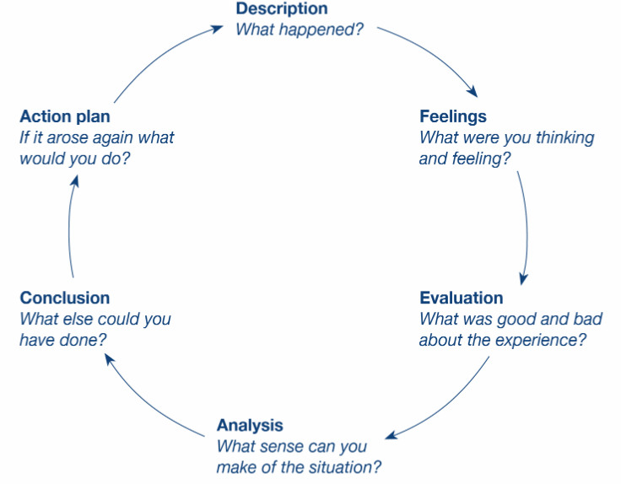
Framework for your reflective writing (Gibbs, 1988)

Slide 11
Analysing the reflective model
Look at the reflective model by Gibbs (1988) and do Activity 2 in the worksheet in small groups:
How many elements are there in this model? Which is the starting point in the model?
What is involved in each element?
Why is each element important in this reflective cycle?
Have you seen any other reflective models? How are they different from this one?
As you see, this model was introduced in 1988? Do you think it is still relevant and applicable? Why?
(Answers are currently accessible by the lecturer; students can access them by the end of the week)

Slide 12

In the coming weeks, we are going to look at the six phases one by one, in addition to other aspects of reflective writing. Now, let us look at the INTRODUCTION of your assignment.

Slide 13

Introductory section

Slide 14
Introduction - Activity
In pairs / small groups, discuss he following:
Why is an introductory section important in a piece of writing? How does it help the readers?
What do you think should go in an introduction? What is the purpose of each sentence/part in an introduction?
What % of the whole work should an introduction be? 50%?
What is a thesis statement? Why / How does it help the readers? Where do you usually write a thesis statement in a piece of writing?
Does an introduction need an outline? Why (not)?
(Possible answers may be available with your lecturer).
Hull University College, 2022
Notes:
https://canvas.hull.ac.uk/courses/778/pages/paragraph-structure

Slide 15
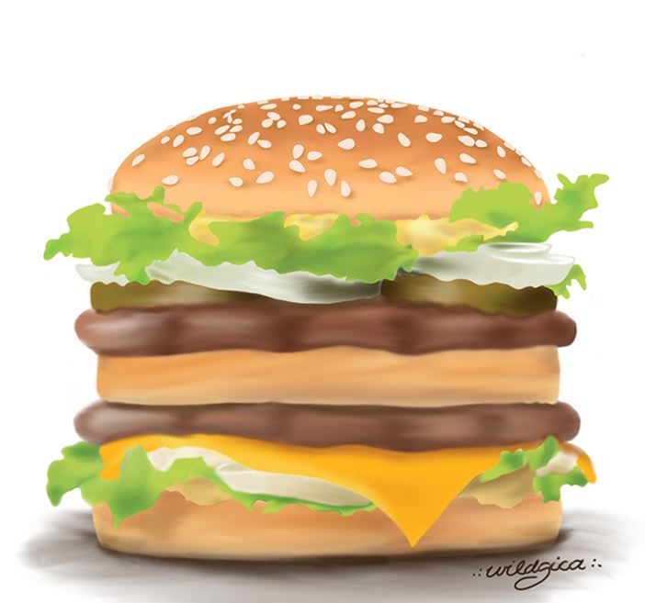
Introductory paragraph
So, let us sum up that:
an introductory paragraph contains:
Opening sentence
Background details
Thesis statement
Outline

Slide 16
Opening sentence
The first sentence of the introductory paragraph introduces the topic/theme to the readers. It helps readers know what the topic is.
For example,
Topic: Reflective writing on how you used technology in your lessons/lectures
Opening/introducing the topic: Technology plays a very big role in the life of a successful student.
Can you come up with an opening sentence for this topic? Reflective writing on your greatest achievement last year
Ans: Achievements help us value ourselves and what we do.

Slide 17
Background details
Here the writer gives more details on the topic; they flow from general to more specific.
For example, Topic: Reflective writing on how you used technology in your lessons/lectures
Technology plays a very big role in the life of a successful student. It is highly unlikely that technology will not offer a solution to a university student’s problem, whether it is related to the subject they are studying, working on assignments, student union, researching, reading materials or academic support. Since I started my degree course at ARUL, I have also relied on technology for various matters, and I feel very positive about the benefit of using technology in studies.
As you see above, the writer has moved from general in the beginning to more specific towards the end.
Notes:
Source: Oshima & Hogue (2007).

Slide 18
Activity 3: Opening sentence + Background details
Go to Activity 3 in Week 2 worksheet.
Topic: Reflective writing on your greatest achievement last year
Activity: Continue the paragraph by adding background details. Try to move from general to specific. Write 2 or 3 sentences (5 minutes).
Achievements help us value ourselves and what we do…
After 5-6 minutes, work in pairs, look at each other’s work and give some feedback.
(Your lecturer may be able to show you a sample answer).

Slide 19

Break: max. 15 mins

Slide 20
Thesis statement and outline
A thesis statement states the main idea of the whole writing.
A thesis statement in an essay is like the topic sentence of a paragraph.
A thesis statement also uses appropriate signposting language such as, The main ideas discussed in this work are…
This work will describe, evaluate and analyse…
The thesis statement may also indicate the pattern of organisation of the essay. This outline can be written as a separate sentence, or embedded within the thesis statement. For example,
This essay will first look at the literature relevant to the strategy, then present the problems in implementing this strategy and finally suggest possible solutions to them.

Slide 21
Example thesis statement Topic: Reflective writing on how you used technology in your lectures Technology plays a very big role in the life of a successful student. It is highly unlikely that technology will not offer a solution to a university student’s problem, whether it is related to the subject they are studying, working on assignments, student union, researching, reading materials or academic support. Since I started my degree course at ARUL, I have also relied on technology for various matters, and I feel very positive about the benefit of using technology in my studies. This work presents a reflective commentary on the role of technology in my studies. After describing the topic and commenting on my feelings and thoughts on it, I will evaluate and analyse the experience I have had so far in relation to the topic. In the latter part, I will present my conclusions of my reflections and possible action plan for future improvement. Opening sentence Background details Thesis statement Outline

Slide 22

Activity 4: Thesis statement + outline
Go to Activity 4 in Week 2 worksheet.
Complete the Introductory paragraph by adding a thesis statement and an outline, if needed.
Then, work in pairs, look at each other’s work and give some feedback.
(Your lecturer may be able to show you a sample answer).
Note: (Note: In the possible answer, the
outline has been embedded within
the thesis statement)

Slide 23
Homework – Writing (from week 1)
Your writing homework from week 1 was to write a short reflection on an event / situation / experience you had (which you shared with your friends in groups last week).
Work in pairs, exchange your written works and give some constructive feedback to your partner.
Talk about what they did well and what they can do even better.

Slide 24
Assignment topics
Here are the three topics for your CS1 assignment; you will write a reflective paper on ONE of the topics.
Materials and activities used in your lessons/lectures
ARUL campus facilities and amenities
Involvement and participation in your lessons/lectures
Your writing homework for this week is to write the Introduction to your reflective paper.
Work in pairs / small groups and discuss the three topics and the topic you are likely going to reflect on. You may change your topic any time during the course, but the earlier you decide on one, the better.

Slide 25


Slide 26
A special note on your writing HW
Each week from weeks 2 – 8, you will get writing HWs which are directly linked to your assignment, so writing HW is very important.
If you decide to write your final reflective assignment on the topic you have chosen in week 1 or 2, you may combine all your writing HWs together which may make your final submission. Of course, you may need to add/delete and amend aspects in your work before submitting it.
But if you want to write your final paper on a different topic, you are free to do so too, but you will need to write it from scratch – it is entirely up to you!

Slide 27
Independent study
Go to the ‘Independent study’ section under Week 2 tile.
READ: Reflective Writing pp. 7-13 (Getting started on reflective writing) (PDF attached or click the link on VLE)
ANSWER: Homework Quiz 2 on VLE (to be done after reading pp. 7-13)
WRITE: Week 2 Independent Study Writing Activity
WATCH: Videos in ‘Week 2 Preparation Resources’

Slide 28
References
https://www.ed.ac.uk/reflection/reflectors-toolkit/reflecting-on-experience/gibbs-reflective-cycle
Gibbs, G (1988). Learning by doing: a guide to teaching and learning methods. Oxford: Further Education Unit, Oxford Polytechnic
https://www.mmu.ac.uk/media/mmuacuk/content/documents/careers/Applying-the-Gibbs-Model-2018.pdf
Open University, Skills for OU Study. Be aware of your habits. [online]. Available at: www2.open.ac.uk/students/skillsforstudy/ be-aware-of-your-habits.php [Accessed 5 July 2022]
[Accessed 5 July 2012] Plymouth University, Learning Development. (2010) Reflection [online]. Available at: www.learningdevelopment.plymouth.ac.uk/ LDstudyguides/pdf/11Reflection.pdf [Accessed 5 July 2022]
Williams, K, Woolliams, M and Spiro, J (2020). Reflective Writing. Basingstoke: Palgrave MacMillan

